Slide 1
Lecture 1a: Introduction to Computer Architecture
To watch lecture video click link below
Lecture 1a video
To view slides, continue to next slide

Slide 2
Lecture 1a: Introduction to Computer Architecture
Acknowledgement: imported figures (other than cited) are taken from the textbook with copyright belonging to the publisher and the authors.

Slide 3
Computer Architecture: Overview
Rapidly changing field:
vacuum tube -> transistor -> IC -> VLSI
Two key areas:
memory capacity processor speed (Due to advances in technology and organization)
Things you’ll be learning:
how computers work, a basic foundation
how to analyze their performance (or how not to!)
issues affecting modern processors (pipelines, caches)

Slide 4
Major Components of a Computer
Components:
input (mouse, keyboard) & output (display, printer)
CPU, i.e. Processor
memory (disk drives, DRAM, SRAM, …)
Network
Our primary focus: the processor
datapath and control
implemented using millions of transistors
Impossible to understand by looking at each transistor
So we need …

Slide 5
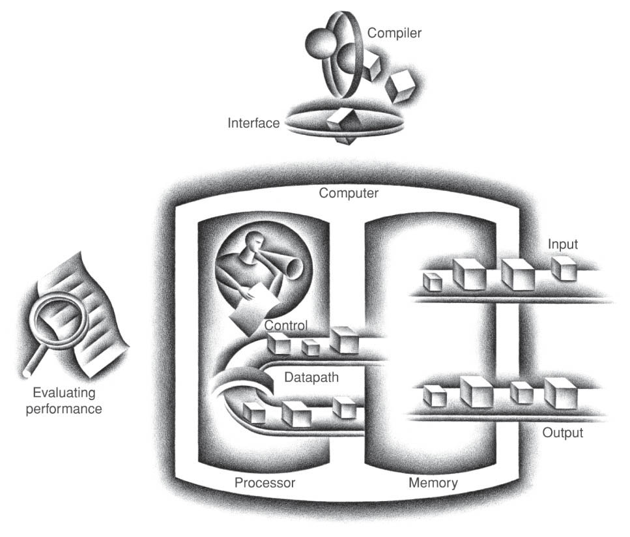
Computer Abstraction
This figure shows the abstraction of the five components of a computer

Slide 6
Classes of Computers
Desktop computers
General purpose, variety of software
Subject to cost/performance tradeoff
(now include laptops, tablets, …)
Server computers
Network based
High capacity, performance, reliability
Range from small servers to building sized
(e.g. HPC – high performance computing cluster)
Embedded computers
Hidden as components of systems
Stringent power/performance/cost constraints

Slide 7
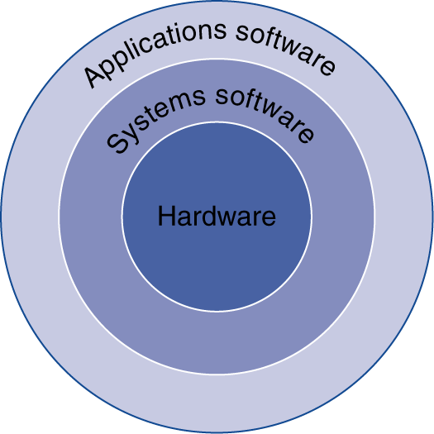
Below Your Program
Application software
Written in high-level language
System software
Compiler: translates HLL code to machine code
Operating System: service code
Handling input/output
Managing memory and storage
Scheduling tasks & sharing resources
Hardware
Processor, memory, I/O controllers

Slide 8
The Study of Computer Architecture
Computer architecture is a set of rules and methods that describe the functionality, organization, and implementation of computer systems. Source: https://en.wikipedia.org/wiki/Computer_architecture
Functionality: layer of abstraction above the organization
description of components functionality
Organization: layer of abstraction above the digital logic
modular design of hardware components
Implementation: hardware implementation (details)

Slide 9
Computer Organization
vs.
Computer Architecture

Slide 10
CS264/CS2640
A required prerequisite course
Title: Computer Organization and Assembly Programming
Catalog description
Number representation, integer arithmetic. Von Neumann machine. Instruction set architecture. Addressing modes. Assembly programming. Arrays and records. Subroutines and macros. Interrupts. I/O interfacing and communication.

Slide 11
Von-Neumann Machine
Stored program concepts
CPU
Instruction Execution Steps:
Fetch Instruction
Decode & fetch operands
Execution
Write Results
(repeat for next instruction)
Control
instruction/data
Memory

Slide 12
Binary Representation of Data
Integer
2’s complement representations 1101 1101 (-35)
signed/unsigned representations 0010 0011 (35)
Floating point
IEEE 754 standard for FP # representations
3.25 => 0 1000 0000 1010 0000 0000 0000 0000 000
Hope you’re familiar with these terms; if not, extra efforts to be spent on these prerequisite topics. Following lectures will contain a quick review of topic A and detailed review of topic B.

Slide 13
Integer Arithmetic
Binary addition, subtraction, multiplication, …

Slide 14
Instruction Set Architecture
A very important abstraction
interface between hardware and low-level software
standardizes instructions, machine language bit patterns, etc.
advantage: different implementations of the same architecture
disadvantage: sometimes prevents using new innovations
Modern instruction set architectures:
80x86/Pentium/K6, PowerPC, DEC Alpha, MIPS, SPARC, PA-RISC, …

Slide 15
Instruction Set Architecture (ISA)
MIPS Instruction Set
Simple in Design
Should be able to pick up quickly if the assembly for your CS264/2640 is not MIPS
Detailed MIPS instruction set can be found in zyBook Table 2.2.2 in section 2.2.
We only cover a small subset
add, sub, and, or, beq, bne, addi, lw, sw, andi, ori, j, jal, jr
The above subset of MIPS will be introduced in the following lectures. However, students are expected to have a general understanding of ISA.

Slide 16
Addressing Modes
Once we fetch an instruction, how can we locate the data needed for the operation?
Addressing modes tell us how we fetch data
MIPS uses five simple addressing modes
Immediate addressing
Register addressing
Base addressing
PC-relative addressing
Pseudo-direct addressing
Addressing modes will be reviewed in later lectures.

Slide 17
Remember what you learned in CS264/2640?
Chapter 2 and Appendix A cover all topics presented CS264/2640. To succeed in CS3650 background knowledge very important.
Browse these topics and refresh your mind!

Slide 18
Computer Architecture:
Architectural view: big picture, focus on design;
How hardware components are connected together to form a computer system.
Computer Organization:
Structure and behavior of a computer system;
How components/features are implemented;
care about details

Slide 19
Figure credit: https://www.geeksforgeeks.org/

Slide 20
Our Approach
Computer/Digital Logic & Finite State Machines
Basic circuit design
Instruction Set Architecture (ISA)
An interface between hardware and software, illustrated in MIPS
Design & implementation of arithmetic operations
Number representations; integer and FP operations
Processor datapath
Schematic diagrams
Control Design
Truth table
Advanced technologies such as pipelining, memory hierarchy, …
Concepts and principle of operations

Slide 21
To-Do List
Study zyBook Chapter 1
Read text; while reading do the participation activities
Section 1.1, 1.3 and 1.4 are required
Other sections are interesting to read too.
Get connected with classmates
Discussion questions or any course related topic
Or, just to know some new friends
Now, take a deep breath, stretch to relax…

